Slide 1
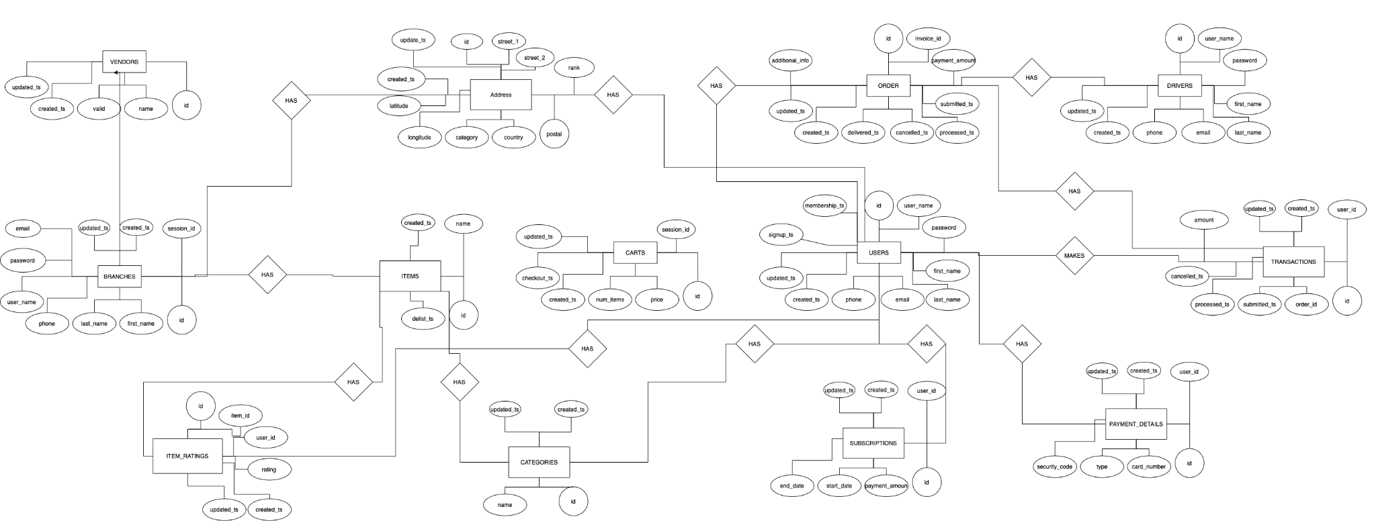
Carriage’s ER Diagram - Conceptual

Slide 2
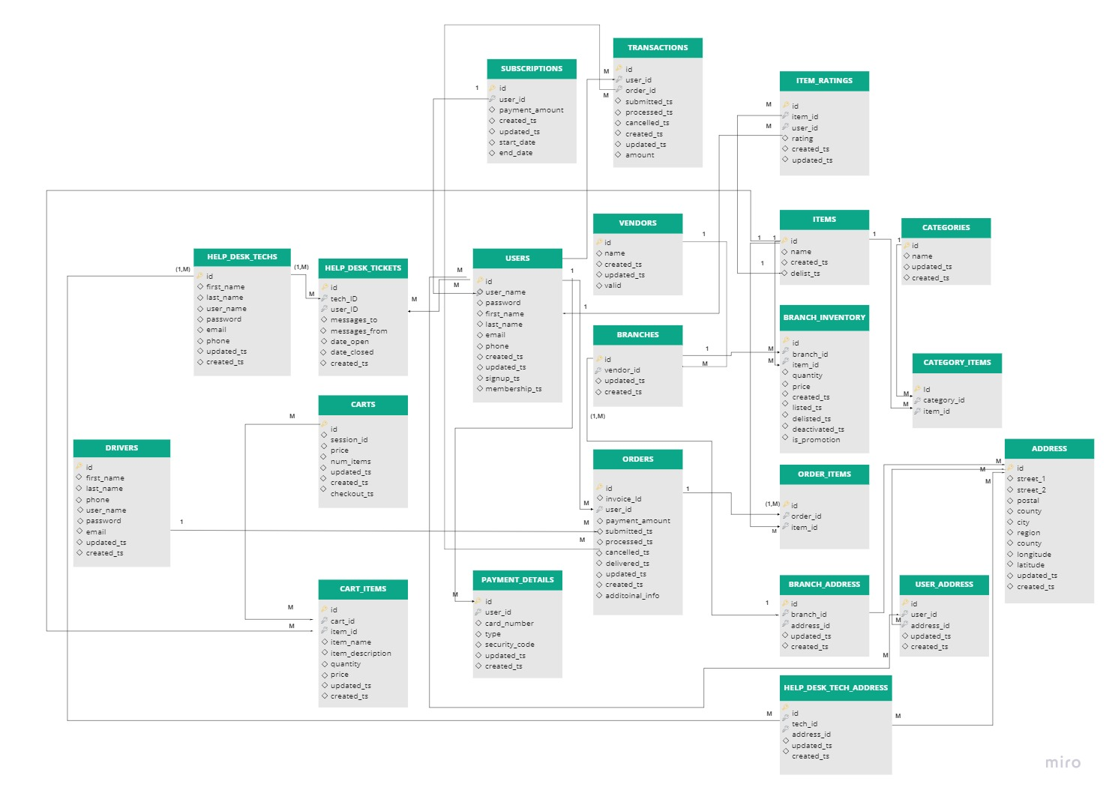
Carriage’s ER Diagram - Logical

Slide 3
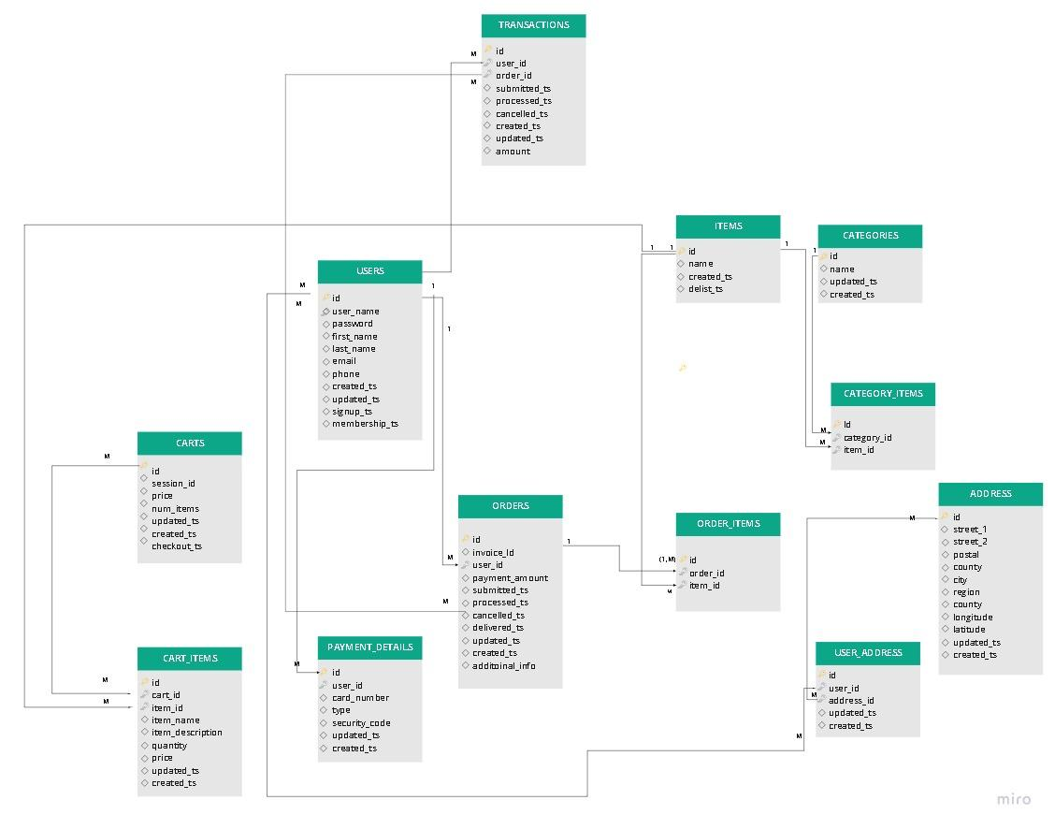
Carriage’s ER Diagram - Logical (I1, I2)

Slide 4
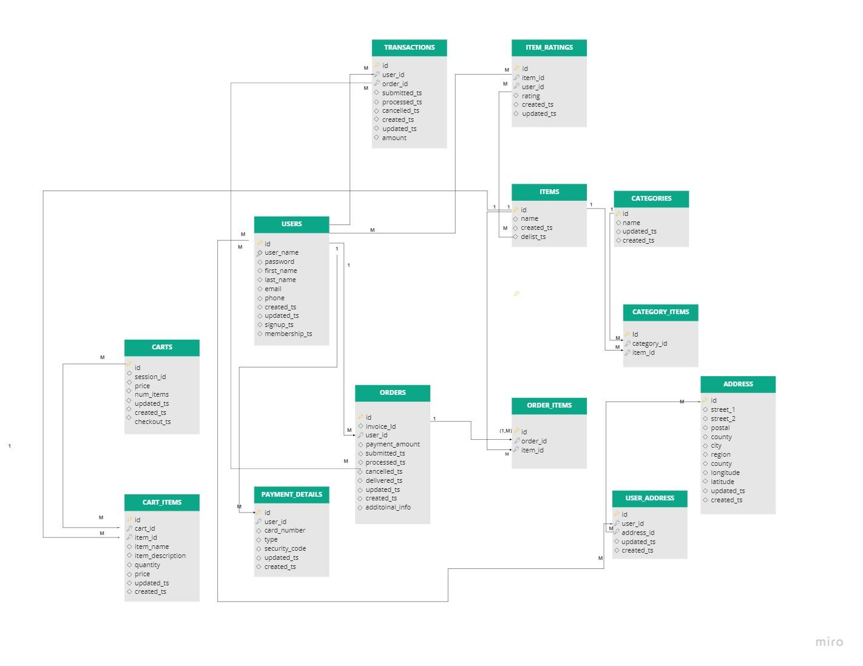
Carriage’s ER Diagram - Logical (I3,I4)

Slide 5
Revision Notes
Conceptual Diagram more aligned with Logical Diagram relationships , names and columns.

